Slide 1

Machine Learning Lesson 1: Hands On Assignment
By Evangeline Sargeant

Slide 2



Table of Contents
Step 1: Converting Categorical Data to Quantitative Data
Step 2: Data Wrangling
Step 3: Cross Validation using K-fold Cross Validation
Step 4: Setting up Linear Regression and Predictions
Step 5: Accuracy Score and Examining Error

Slide 3




Goal
With the “diamonds” dataset, the goal is to accurately predict the price of diamonds. The variables we are using are carat, cut, color, and clarity. Using Machine Learning, we will train and test the algorithm created.

Slide 4

Step 1: Converting Categorical to Quantitative Data
When analyzing the variables, I noticed that cut, color, and clarity were categorical data.
Machine Learning can only work on numerical data.
Using Label Encoder from sklearn.preprocessing package we were able to convert the columns and append them to the original data set.
Dropped the original columns from the “diamonds” dataset as well

Slide 5
Step 2: Data Wrangling
Once the variables were in the correct format, we set up the x and y variables as their own arrays
Using train test split from the sklearn package, we split the dataset into 4:
X_train
X_test
Y_train
Y_test

Slide 6
Step 3: Cross Validation using K-fold Cross Validation
K-Fold Cross Validation is a way to test if the split was random and there wasn’t any bias introduced into the model.
Once completed the cross validation, the three iterations came out with an average score of 88.1%
This means that model was accurate about 88.1% of the time, which means it stood up to the test.

Slide 7
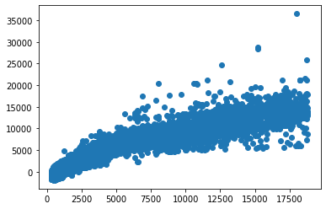
Step 4: Setting Up Linear Regression and Predictions
Setup the linear regression using x_train and y_train datasets
Used lm.predict on x_test dataset to setup pricing predictions, and then created a scatter plot with y_test dataset and predictions.

Slide 8
Step 5: Accuracy Score and Examining Error
Accuracy Score= 87.6%
Examining Error using RSME= 1395.66
Examining Error using MAE= 939.65
The goal is for the error to be close to zero. First, I ran the RSME since it is the most popular and it penalizes large errors compared to MAE.
When the RSME came out so large, I ran MAE next to compare.
This means that the predicted data is not close to the real data analyzed.

Slide 9

The way to get started is to quit talking and begin doing.
Walt Disney

Slide 10

Summary
In the end, the algorithm was able to accurately predict prices, but more data will be needed to have a better fitting model.

Slide 11


Thank You
Evangeline Sargeant

